Slide 1
Arabic 2 Kurzban Welcome to Arabic 2 by Kurzban
Lesson 13: Colors, Day 1 (White, black, green and yellow)
Warm up: Connecting letters.
Practice
Homework:

Slide 2
اهلا وسهلا, اسمي هالة. عندي كلب Brown
Quiz

Slide 3
هذه سيارتي Red امام بيتي White

Slide 5
Lesson 10:
Warm up: Connect the following letters: Provide the transliteration to each
أ+ح+م+د=
م+و+ج=
ه+ن+ا+ك=
م+ا+ىء+د+ة=

Slide 6
Learning Your Colors
White
Black
أبيض
Feminine colour adjective
بيضاء
أسود
Feminine colour adjective
سوداء

Slide 7
Describe the following using This is for M and This is for F
Glass bottle
White dog

Slide 8
Describe the following using This is for M and This is for F
Black Tent
Black Dog

Slide 9
Now say: This is a white picture and it’s beautiful and it’s on the desk.
Provide its transliteration as well.

Slide 10
Now write: This is my dog and he is in my black tent
Write the translation for your sentence

Slide 11
Describe what you see!
Green
Yellow
أخضر
خضراء
أصْفر
صفراء

Slide 12
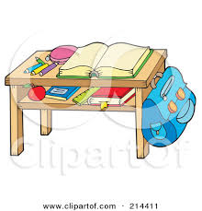
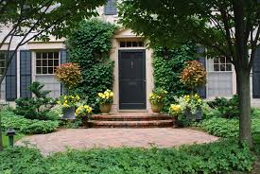
Do now: Describe what you see in Arabic
There are Green Trees in front of the door
There is a Green book on the desk

Slide 13
Homework: Write in Arabic the following four sentences: It will be collected and graded.
My family is in the new, green car.
My white backpack is next to my desk
I have a beautiful yellow rose.
I love my black car in front of the house.

Slide 14
Arabic 2 Kurzban
Lesson 13: Colors, Day 2 ( Pink, and brown)
Warm up: Go over HW
Connecting letters.
Practice
Homework:

Slide 15
Do Now: Connect the following letters to form words and provide the transliteration
ا+ل+صَّ+ي+ف=
ا+ل+شِّ+ت+ا+ء=
ا+ل+خ+ر+ي+ف=
ا+ل+رَّ+ب+ي+ع=
خ+ض+ر+ا+ء=
ص+ف+ر+ا+ء=

Slide 16
Review Of days of the week and corresponding's days of the week.
Sunday ( Arabic) _______________________________________واحد
Monday (Arabic)_______________________________________إثنان
Tuesday (Arabic)_______________________________________ثلاتة
Wednesday (Arabic)_____________________________________أربعة
Thursday (Arabic) _______________________________________خمسة
Friday (Arabic)_________________________________________ستَّة
Saturday (Arabic)___________________________________________سبعة

Slide 17
Describe what you see!
Pink وردي وردية/
Brown بُنِّي
بنِّية/
Translate the following sentence: أنا أحِبٌ قَلمي الورْدي
Translate the following sentence: أنا أحِبٌ قَميصي البُنِّي

Slide 18
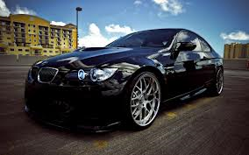
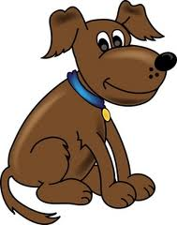
Use the following vocabulary to compile a full sentence: Brown dog, pink tent, there is, a car, black , under or above, next to, and,

Slide 19
Homework: Write in Arabic the following four sentences: It will be collected and graded.
My family is in the new, pink car.
My pink backpack is next to my desk
I have a beautiful pink shirt.
I love my brown car in front of the house.

Slide 20
Arabic 2 Kurzban
Lesson 13: Colors, Day 3 (Blue and purple, gray and orange
Warm up: Go over HW
Connecting letters.
Practice
Homework:

Slide 21
Review: What are the seasons of the year in Arabic: refer to notes from last class

Slide 22
Underline the word that does not belong and explain your choice:
أخضر نافدة بني
الربيع
اصفر شباك بورقة قلم اب

Slide 23
Describe what you see!
Purple
Blue
Masculineأرجواني
أرجوانية
Masculine: أزرق
Feminine: زرقاء

Slide 24
Describe what you see!
Orange
Gray
برتقالي
Feminine:
رمادي
Feminine:

Slide 25
Summary: Colours:

Slide 26
Let’s make some sentences; Use any of the vocab we have discussed previously and construct 4 complete sentences.
Make sure you use any of the colors, classroom surrounding and be creative

Slide 27
Class Work: Put these sentences in the right order
جديدة سيارة أمام هناك المصنع
مكسور هناك الطاولة قلم على

Slide 28
في الجميلة الجديدة أنا سيارتي
في جديد هناك المدرسة ولد

Slide 29
Homework: Translate the following from English to Arabic: Bank, on the right of , there is, black, ugly, factory
Now construct a complete sentence

Slide 30
Translate the following: هذه صُورة مدينة و هناك نهر في المدينة وبجانب النهر هناك شارع. في وسط الصورة هناك بنك وبجانب البنك هناك مدرسة. المدرسة بين البنك و المستشفى. أمام البنك هناك شجر جميل ولكن ليس هناك شجر أمام المصنع

Slide 31
اهلا وسهلا, اسمي سعاد و انا احب سيارتي السوداء امام المدرسة. بجانب سيارتي هناك شجرة صفراء و خلف الشجرة هناك شارع طويل. في مدينتي, هناك مصنع قديم و قبيح.

